Slide 1
Real Deal Cars
Under the Guidance of, Submitted by,
Sr. Elsin Chakkalackal S H Timin Kurian
S6 Reg MCA
Roll No: 51

Slide 2
INTRODUCTION
This project is intended to design and develop a website for car service and sales. The project provides the facility for sales of used cars with cent percent quality assurance.
The registered customers can find the nearby service centres and book services. The registered customers can sell their used cars through the site. The site includes the facility of selling only the cars that have serviced in the registered service centres.
The main advantage of the proposed system is that it avails the full service history of the cars for the interested buyers, so that they can chose the best of them. This facility ensures the descent deal for the sellers too. The registered service centres can provide the complete history of their servicing that has done in their centre.

Slide 3
MODULES
There are 4 modules:
Users
Admin
Service centers
Employees
1. Users
Register cars
Buy used cars
View service schemes
Book an appointment
View service history
Sell vehicle
View the cars for sales
View the service history of the interested cars

Slide 4
2. Service centres
Register Service centre
Add service scheme
Add service history
Manage leave of employees
Manage employees
3. Admin
Approve service centres
Approve the registration of cars
Overall management of the website
4. Employee
Update profile
Apply leave
Manage the appointments

Slide 5
Table Design
Table no: 1
Table name: tbl_ login
Primary key: user_id
Sl. No | Field name | Field type | Size | Constraints | Description
1. | user_id | int | 10 | Primary key | User id
2. | email | varchar | 30 | Not Null | E-mail
3. | password | varchar | 100 | Not Null | Password
4. | Designation_id | int | 10 | Foreign Key | Designation type
5. | status | int | 5 | Not Null | Status of user

Slide 6
Table no:2
Table name: tbl_users
Foreign key: user_id, place_id
Sl. No | Field name | Field type | Size | Constraints | Description
1. | user_id | int | 10 | Foreign Key | User id
2. | place_id | int | 10 | Foreign key | Place id
3. | first_name | varchar | 15 | Not Null | First name
4. | last_name | varchar | 15 | Not Null | Last name
5. | mobile | int | 10 | Not Null | Mobile Number
6. | photo | varchar | 50 | Not null | Profile photo

Slide 7
Table No: 3
Table Name: tbl_Servicecenter
Primary key: licenceno
Foreign key: user_id, place_id
Sl. no | Fieldname | Field type | Size | Constraints | Description
1 | licenceno | Varchar | 10 | Primary key | License number of service center
2 | user_id | int | 10 | Foreign Key | Login id
3 | place_id | int | 10 | Foreign key | Place id
4 | brandid | int | 10 | Foreign key | Brand id
5 | center_name | varchar | 25 | Not Null | Center name
6 | certificate | varchar | 30 | Not Null | License certificate
7 | mobile | int | 15 | Not Null | Mobile number
8 | Photo | varchar | 50 | Not Null | Service center photo

Slide 8
Table No: 4
Table Name: tbl_district
Primary Key: district_id
Table No: 5
Table Name: tbl_place
Primary Key: place_id
Foreign key: district_id
Sl. no | Fieldname | Field type | Size | Constraints | Description
1. | district_id | int | 2 | Primary key | District id
2. | district_name | Varchar | 15 | Not Null | District name
Sl. no | Field name | Fieldtype | Size | Constraints | Description
1. | place_id | int | 10 | Primary key | Place id
2. | district_id | int | 2 | Foreign key | District id
3. | place_name | varchar | 25 | Not Null | Place name

Slide 9
Table No: 6
Table Name: tbl_brand
Primary Key: brandid
Table No:7
Table Name: tbl_model
Primary Key: model_id
Foreign Key: brandid
Sl. no | Field name | Field Type | Size | Constraints | Description
1. | brandid | int | 10 | Primary Key | Brand id
2. | brand_name | varchar | 10 | Primary key | Brand name
Sl. no | Field name | Field type | Size | Constraints | Description
1. | model_id | int | 10 | Primary key | Model id
2. | brandid | int | 10 | Foreign key | Brand id
3. | model_name | varchar | 10 | Foreign key | Model name

Slide 10
Table No: 8
Table Name: tbl_variant
Primary Key: variant_id
Foreign Key: model_id, fuel_id
Table No: 9
Table Name: tbl_fuel
Primary Key: fuel_id
Sl. no | Field name | Field Type | Size | Constraints | Description
1. | variant_id | int | 10 | Primary Key | Variant id
2. | model_id | int | 10 | Foreign key | Model id
3. | fuel_id | int | 2 | Foreign key | Fuel id
4. | variant_name | varchar | 15 | Not Null | Variant
Sl. no | Field name | Field type | Size | Constraints | Description
1. | fuel_id | int | 2 | Primary Key | Fuel id
2. | fuel | varchar | 10 | Not null | Fuel type

Slide 11
Table No:10
Table Name: tbl_servicescheme
Primary Key: scheme_id
Foreign Key: licenceno, variant_id, department_id, action_id
Sl. no | Field name | Field type | Size | Constraints | Description
1. | scheme_id | int | 5 | Primary Key | Service scheme id
2. | licenceno | varchar | 25 | Foreign key | License number
3. | variant_id | int | 10 | Foreign key | Variant id
4. | department_id | int | 10 | Foreign key | Department id
5. | action_id | int | 10 | Foreign key | Action id
6. | scheme_name | varchar | 10 | Not null | Service scheme name
7. | amount | int | 10 | Not null | Price

Slide 12
Table No: 11
Table Name: tbl_department
Primary Key: department_id
Table No: 12
Table Name: tbl_workcount
Primary Key: count_id
Foreign Key: licenceno
Sl. no | Field name | Field type | Size | Constraints | Description
1. | department_id | int | 10 | Primary Key | Department id
2. | department_name | Varchar | 25 | Not null | Department type
Sl. no | Field name | Field type | Size | Constraints | Description
1. | Count_id | int | 10 | Primary key | Count id
2. | department_id | int | 10 | Foreign key | Department id
3. | date | date |  | Not null | Date
4. | count | int | 10 | Not null | Work count
5. | licenceno | varchar | 10 | Foreign key | License number

Slide 13
Table No: 13
Table Name: tbl_car
Primary Key: carid
Foreign Key: user_id, variant_id
Sl. no | Field name | Field type | Size | Constraints | Description
1. | carid | Int | 10 | Primary key | Car id
2. | user_id | int | 10 | Foreign key | User id
3. | variant_id | int | 10 | Foreign key | Variant id
4. | manufacture_year | int | 10 | Not null | Manufacturing year
5. | color | varchar | 10 | Not null | Car color
6. | regno | varchar | 20 | Not null | Registration number
7. | engineno | varchar | 18 | Not null | Engine number
8. | chasisno | varchar | 18 | Not null | Chasis number
9. | rcbook | varchar | 30 | Not null | Rc book image
10. | photo | varchar | 30 | Not null | Car image
11. | status | int | 10 | Not null | Status

Slide 14
Table No: 14
Table Name: tbl_images
Primary Key: image_id
Foreign Key: advertisement_id
Sl. No | Field name | Field type | Size | Constraints | Description
1. | image_id | int | 10 | Primary key | Image id
2. | advertisement_id | int | 10 | Foreign key | Advertisement id
3. | image1 | varchar | 100 | Not null | Car image11
4. | image2 | varchar | 100 | Not null | Car image2
5. | Image3 | varchar | 100 | Not null | Car image2
6. | Image4 | varchar | 100 | Not null | Car image2

Slide 15
Table No: 15
Table Name: tbl_appointment
Primary Key: apid
Foreign Key: scheme_id, licenceno
Sl. No | Field name | Field type | Size | Constraints | Description
1. | appointment_id | int | 10 | Primary key | Appointment id
2. | registerno | varchar | 20 | Not null | Car register no
3. | scheme_id | int | 10 | Foreign key | Scheme id
4. | licenseno | varchar | 20 | Foreign key | Service center license number
5. | appointment_date | date |  | Not null | Date
6. | remarks | varchar | 500 |  | Remarks from service center
7. | odometer | int | 10 | Not null | Odometer reading
8. | book_date | varchar | 20 | Not null | Booking made date
9. | appointment_status | int | 10 | Not null | Appointment status

Slide 16
Table No: 16
Table Name: tbl_incomplete
Primary Key: incomplete_id
Foreign key: appointment_id
Table No: 17
Table Name: tbl_checking
Primary Key: checking_id
Foreign Key: scheme_id, spare_id
Sl. No | Field name | Field type | Size | Constraints | Description
1. | incomplete_id | int | 10 | Primary key | Action id
2. | appointment_id | int | 10 | Foreign key | Appointment_id
3. | reason | varchar | 300 | Not null | Reason of incomplete
4. | delivery_date | varchar | 20 | Not null | Expected work completion date
Sl. No | Field name | Field type | Size | Constraints | Description
1. | checking_id | int | 10 | Primary key | Checking id
2. | scheme_id | int | 10 | Foreign key | Service scheme id
3. | spare_id | int | 10 | Foreign key | Spare id

Slide 17
Table No: 18
Table Name: tbl_replacing
Primary Key: replacing_id
Foreign Key: scheme_id, spare_id
Table No:19
Table Name: tbl_spare
Primary Key: spare_id
Sl. No | Field name | Field type | Size | Constraints | Description
1. | replacing_id | int | 10 | Primary key | Replacing id
2. | scheme_id | int | 10 | Foreign key | Service scheme id
3. | spare_id | int | 10 | Foreign key | Spare id
Sl. No | Field name | Field type | Size | Constraints | Description
1. | spare_id | int | 10 | Primary key | Spare id
2. | spare | varchar | 20 | Not null | Spare name

Slide 18
Table No: 21
Table Name: tbl_carcondition
Primary Key: condition_id
Foreign Key: appointment_id, employee_id
Sl. No | Field name | Field type | Size | Constraints | Description
1. | condition_id | int | 10 | Primary key | Condition id
2. | appointment_id | int | 10 | Foreign key | Appointment id
3. | employee_id | int | 10 | Foreign key | Employee id
4. | started_time | timestamp |  | Not null | Work started time
5. | odometer | int | 10 | Not null | Odometer reading
6. | fuel | varchar | 20 | Not null | Fuel condition
7. | damage | varchar | 500 |  | Damages of car

Slide 19
Table No: 22
Table Name: tbl_employee
Primary Key: employee_id
Foreign Key: licenceno, department_id,user_id,place_id
Sl. No | Field name | Field type | Size | Constraints | Description
1. | employee_id | int | 10 | Primary key | Employee id
2. | licenceno | varchar | 15 | Foreign key | Licence number
3. | department_id | int | 10 | Foreign key | Department id
4. | first_name | varchar | 25 | Not null | Employee first name
5. | last_name | varchar | 25 | Not null | Employee last name
6. | user_id | int | 10 | Foreign key | User id of employee
7. | Mobileno | int | 10 | Not null | Mobile number
8. | place_id | int | 10 | Foreign key | Place id
9. | photo | varchar | 200 | Not null | Image of employee
10. | status | int | 10 | Not null | Status of employee

Slide 20
Table No: 23
Table Name: tbl_leave
Primary Key: leave_id
Foreign Key: employee_id
Sl. No | Field name | Field type | Size | Constraints | Description
1. | leave_id | int | 10 | Primary key | Leave id
2. | employee_id | int | 10 | Foreign key | Employee id
3. | date | date |  |  | Date of leave
4. | reason | varchar | 50 | Not null | Leave reason
5. | status | int | 10 | Not null | Leave status

Slide 21
Table No: 24
Table Name: tbl_employeecount
Primary Key: count_id
Foreign Key: licenceno, department_id
Sl. No | Field name | Field type | Size | Constraints | Description
1. | count_id | int | 10 | Primary key | Employee count id
2. | licenceno | varchar | 20 | Foreign key | License Number
3. | department_id | int | 10 | Foreign key | Department id
4. | maximum | int | 10 | Not null | Maximum no of employees

Slide 22
Table No: 25
Table Name: tbl_advertisement
Primary Key: advertisement_id
Foreign Key: car_id
Sl. No | Field name | Field type | Size | Constraints | Description
1. | advertisement_id | int | 10 | Primary key | Advertisement id
2. | car_id | int | 10 | Foreign key | Car id
3. | price | int | 10 | Not null | Expecting price
4. | odometer | int | 10 | Not null | KM driven
5. | description | varchar | 50 | Not null | Description about car
6. | latitude | double |  | Not null | Latitude of location
7. | longitude | double |  | Not null | Longitude of location
8. | advertisement_date | varchar | 20 | Not null | Advertisement posted date
9. | status | int | 10 | Not null | Status of advertisement

Slide 23
Table No: 26
Table Name: tbl_offeredprice
Primary Key: offer_id
Foreign Key: advertisement_id, user_id
Sl. No | Field name | Field type | Size | Constraints | Description
1. | offer_id | int | 10 | Primary key | Offer id
2. | advertisement_id | int | 10 | Foreign key | Advertisement id
3. | user_id | int | 10 | Foreign key | User id
4. | offer_amount | int | 10 | Not null | Offered price
5. | offer_date | varchar | 20 | Not null | Offered date
6. | offer_status | int | 10 | Not null | Offer status

Slide 24
Table No: 27
Table Name: tbl_designation
Primary Key: designation_id
Table No: 28
Table Name: tbl_servicetype
Primary Key: servicetype_id
Sl. No | Field name | Field type | Size | Constraints | Description
1. | designation_id | int | 10 | Primary key | Designation id
2. | designation | varchar | 20 | Not null | Designation
Sl. No | Field name | Field type | Size | Constraints | Description
1. | servicetype_id | int | 10 | Primary key | Service type id
2. | servicetype | varchar | 20 | Not null | Service type

Slide 25
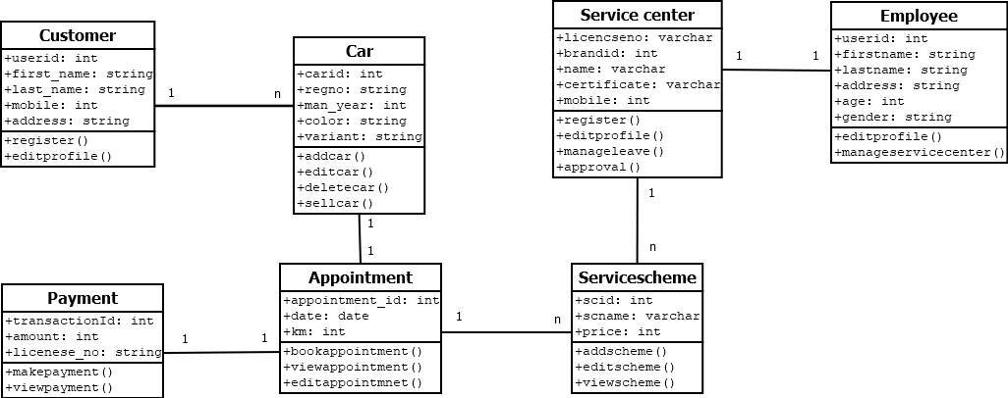
UML - Diagrams
Structural Diagrams
1. Class diagram

Slide 26
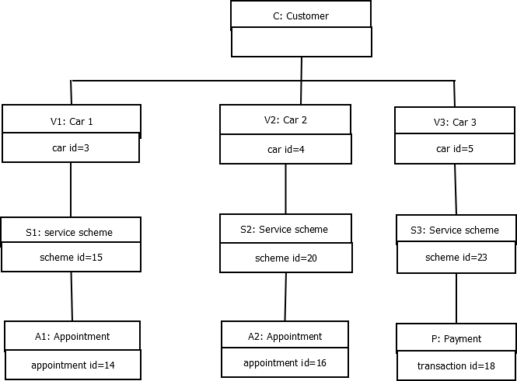
2. Object diagram

Slide 27
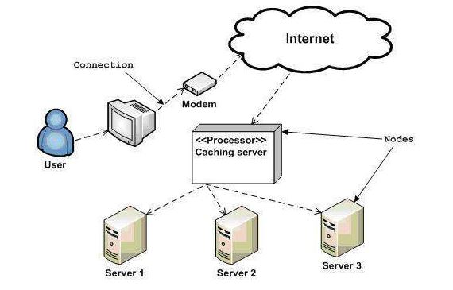
3. Deployment diagram

Slide 28
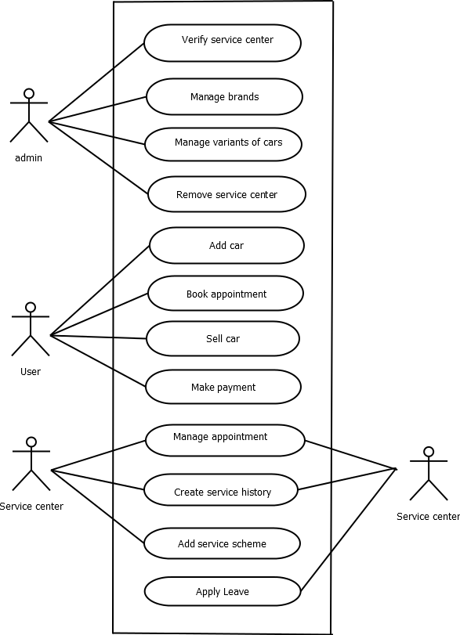
Behavioural Diagrams
1. Use Case diagram

Slide 29
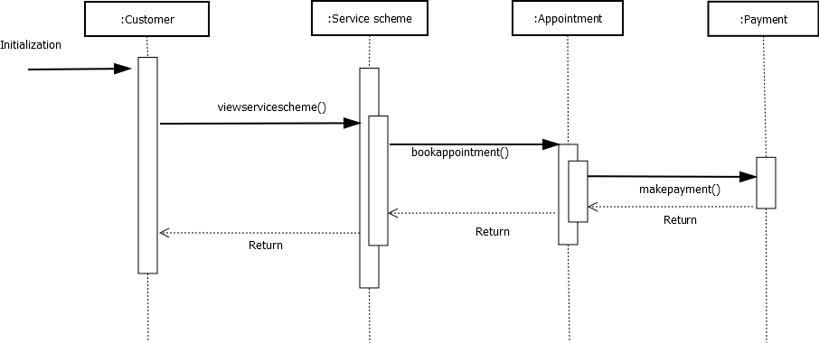
2. Sequence diagram

Slide 30
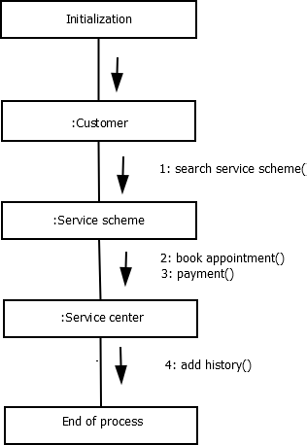
3. Collaboration diagram

Slide 31
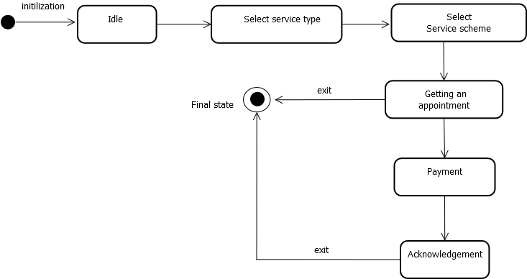
4. State chart diagram

Slide 32
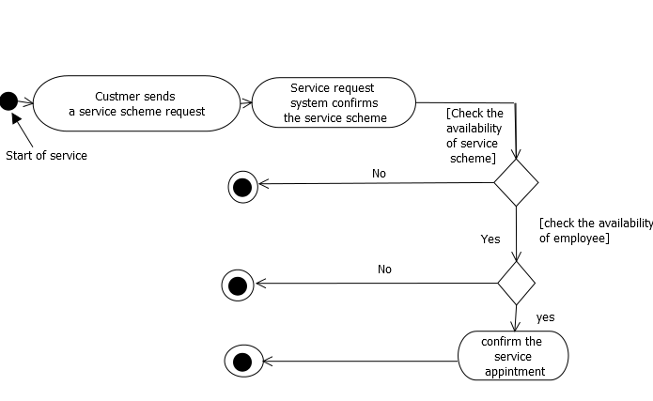
5. Activity diagram

Slide 33
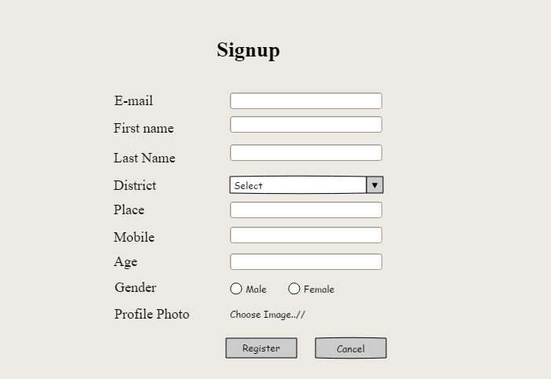
FORM DESIGN

Slide 34
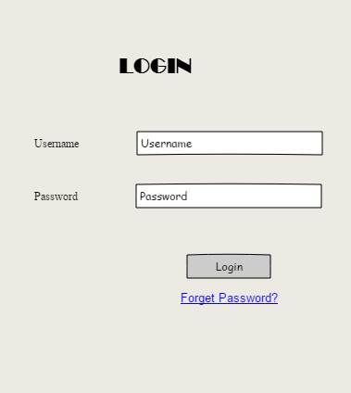

Slide 35
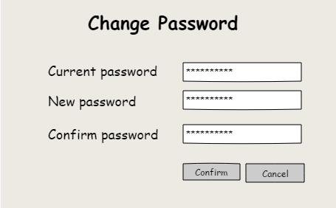

Slide 36
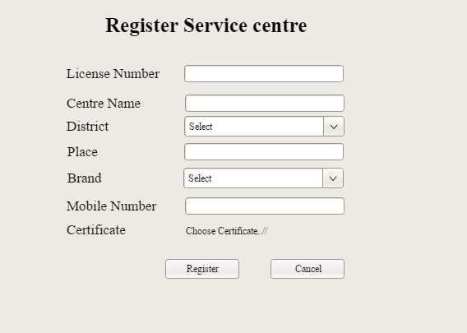

Slide 37
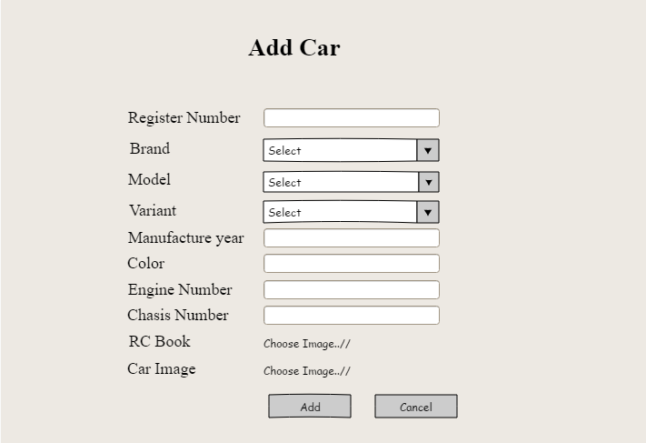

Slide 38
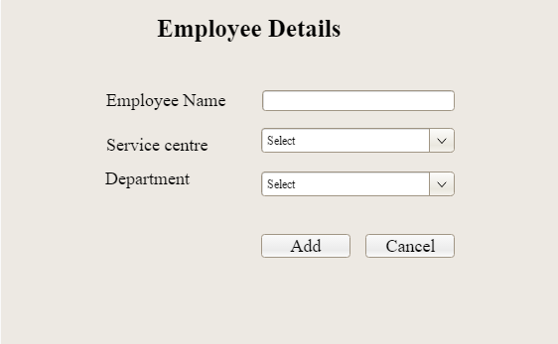

Slide 39
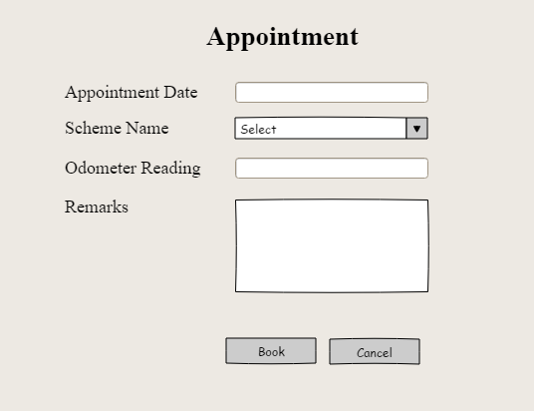

Slide 40
